Slide 1
MLOps Web-Editor
Task 6

Slide 2
Product description
Problem
Pipelines may become big relatively fast. Moreover, pipelines are based on the resources description and involve an extended “YAML” syntax. Therefore, pipelines often happen to be hard to explore and modify.
Solution
A web-editor for pipelines with auto-saving and automatic syntax and cohesion checking, embedded into the “MLOps Platform”. The editor should be based on the existing “MLOps Platform” services, including ones for Authorization and pipeline storing.
Team
Daniil Fedorov, Ilya Sergeev, Andrew Shtanow, Daniil Daragan
Repo
https://github.com/dr0p-table-users/asd

Slide 3
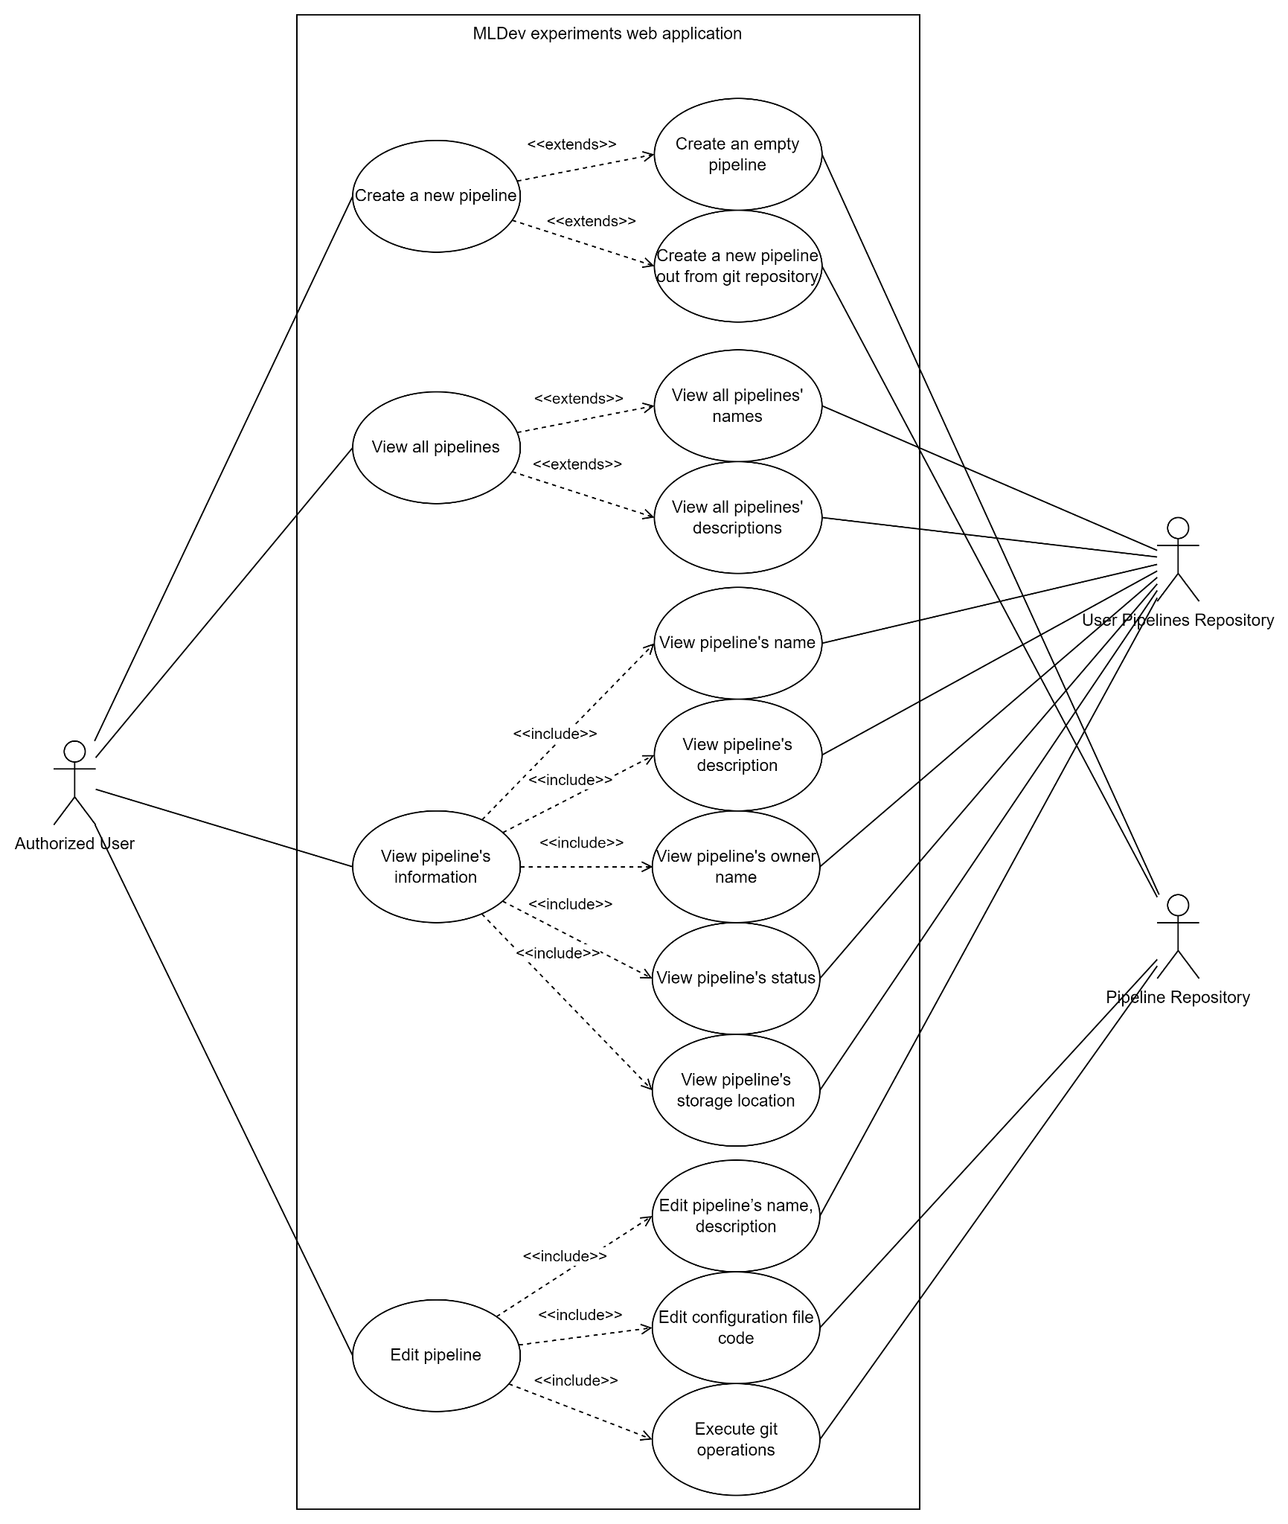
Use case diagram

Slide 4
Interaction analysis
Prepare CRC cards for candidate classes and replay step-by-step the use case scenarios adding which roles fulfill what requirements.
Show a cooperation on a diagram along with the use case
OR. Show as a table, columns: use case - cooperation name - used roles - candidate classes that play them

Slide 5
Interaction analysis
Web-Editor
Responsibility | Colleague (other class)
Store pipeline (Know) | Pipeline Repository
Create pipeline (Do) | Pipeline Repository, Authorization system
View pipeline (Interact) | Pipeline Repository, Authorization system
Edit pipeline (Do) | Pipeline Repository, Authorization system
Check Code (Interact) | Syntax Analyzer
Logging | Log Manager

Slide 6
Interaction analysis
Pipeline Repository
Responsibility | Colleague (other class)
Store Repository data (Know) | User Pipeline Repository
Pull (Do) | User Pipeline Repository
Push (Do) | User Pipeline Repository
Manage Branches (Do) | User Pipeline Repository

Slide 7
Interaction analysis
User Pipeline Repository
Responsibility | Colleague (other class)
Get User Repositories (Know) | Authorization system

Slide 8
Interaction analysis
Authorization system
Responsibility | Colleague (other class)
Store Authorization data (Know)

Slide 9
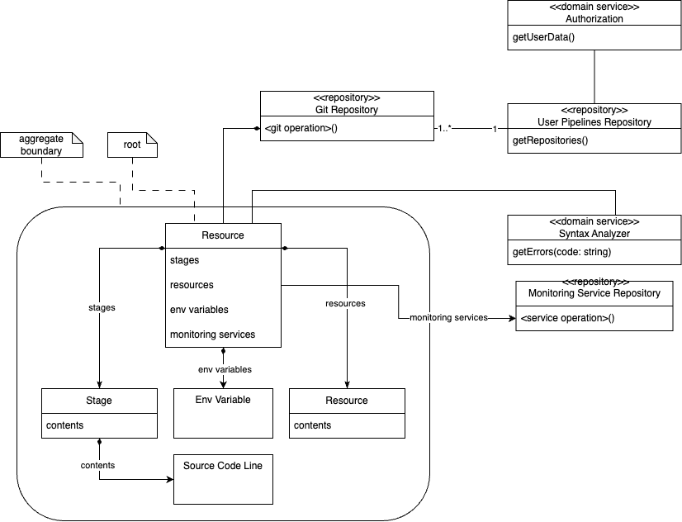
Updated class diagram

